Slide 1
King County House Price Prediction
Data Analysis and Multiple Regression in Python
Presenter: Bonnie Ma
May 2019

Slide 2
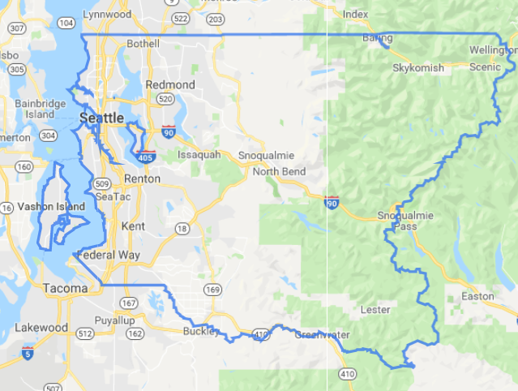
Business Background
King County is one of the most beautiful and populous area in the United States. It is located in the state of Washington and has the population of 2.3 million as of 2018
The growth of companies like Amazon and Microsoft has lifted the house price significantly over the past few years
The goal of this project is to understand the drivers of King County house price and help house owners increase their house value

Slide 3
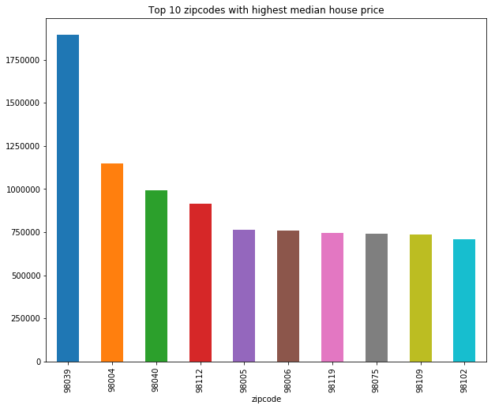
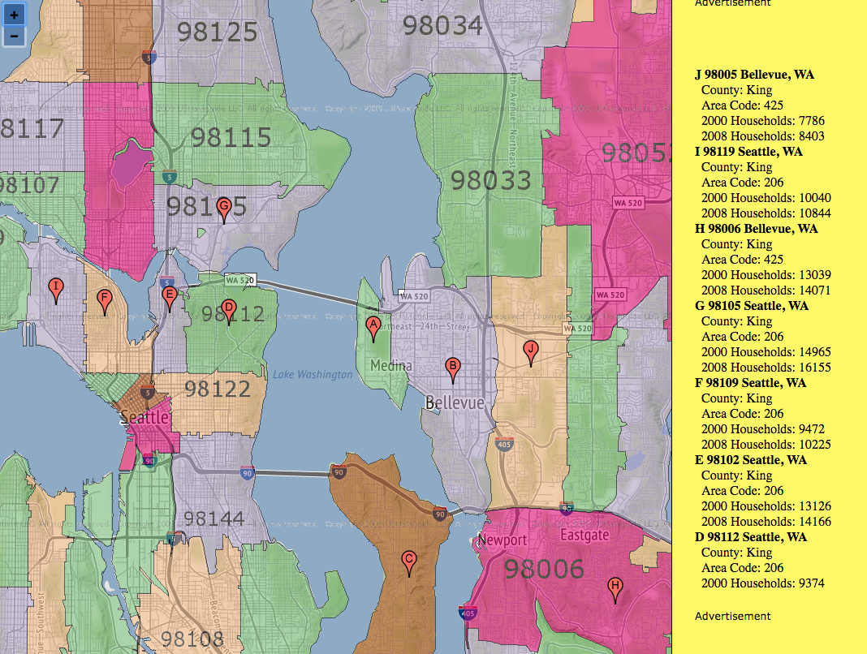
Location is important!
Notes:
Location is the biggest driver in house price. When you open any rental website, the first thing to search is always zipcode or neighborhood.

Slide 4
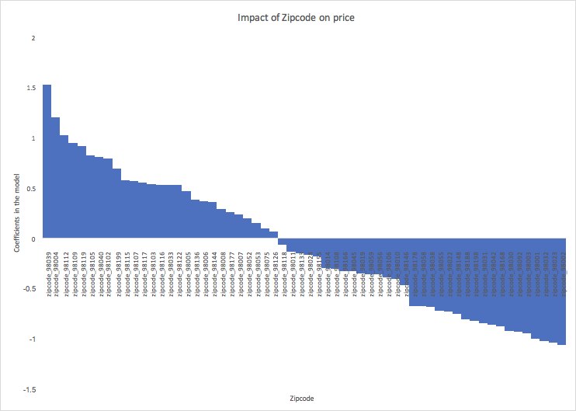
If you want to buy a new house, choose growing areas
Coefficients of zip code tell which area is more referable by the market. For long term investment, it is better to choose zip code with a positive coefficient.
Fastest growing areas
98039
98004
98112
98109
98119
Fastest declining areas
98022
98023
98001
98003
98092

Slide 5
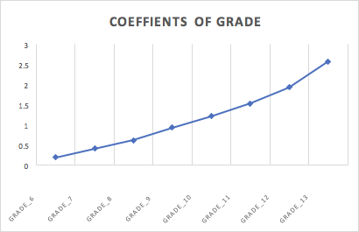
If you can’t change the location, improve the grade of your house!
Higher the grade, the more price increases. Try to renovate your house and get as high grade as possible.

Slide 6
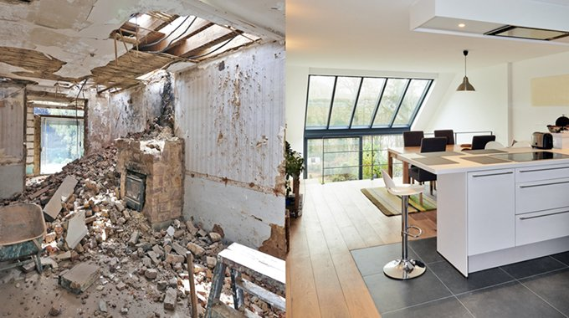
Or renovate to improve the condition.
House condition is a significant factor impacting the house price. Renovation helps improve the house condition.

Slide 7
Appendix
Feedback from the instructor:
Jump out of the coding mode and only include information that is relevant to your story
Think of a scenario for your insights
Be careful of visuals (no technical terms)

Slide 8
Our Approach - OSEMN
Step 1
Data Collection
Goal: build a robust regression model to predict King County house price as accurate as possible
KPIs: Adjusted R-square, Mean Squared Error (MSE)
The data set has 21,597 records and 18 variables.
Step 5
Step 2
Result interpretation
OSEMN
Data Scrubbing
Step 4
Step 3
Feature transformation and model fit
Data Exploration and Visualization
Notes:
This is too technical. Non-technical investors don’t care this.
Goals: to predict the house price as accurate as possible
KPIs: Adjusted R-square, MSE
estimator measures the average of the squares of the errors—that is, the average squared difference between the estimated values and what is estimated. MSE is a risk function, corresponding to the expected value of the squared error loss.

Slide 9
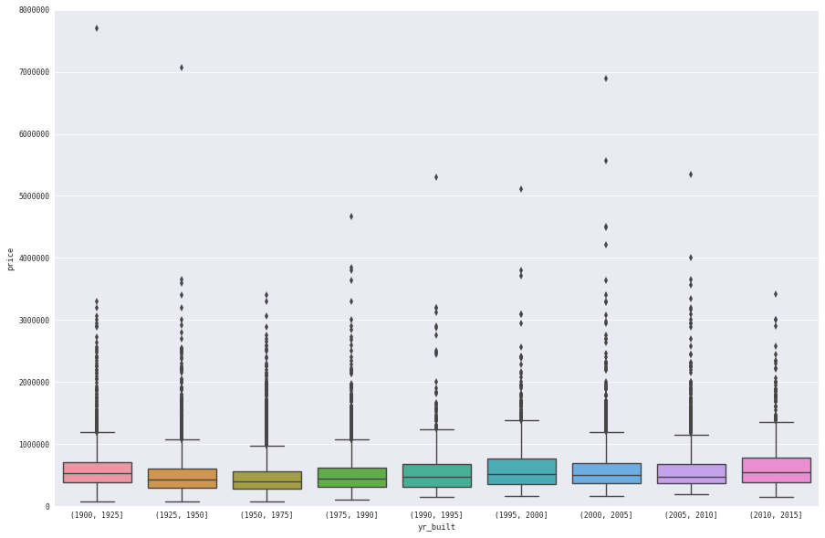
House Price Change Over Time
Notes:
Avg house price topped 2 million in 2014-10

Slide 10
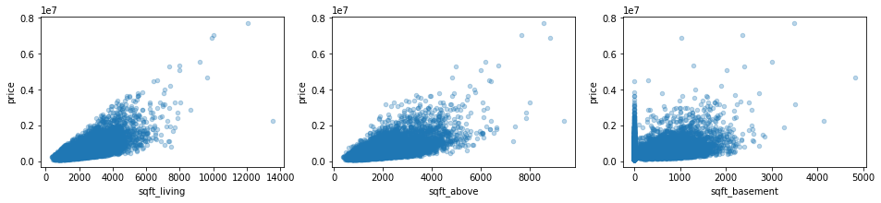
House price vs Footage
Sqft_living: Footage of the home
Sqft_above: footage of house apart from basement
Sqft_basement: footage of the basement

Slide 11
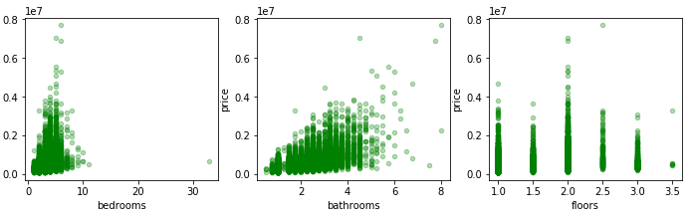
House price vs Bed/Bathrooms/Floors
No obvious correlation observed between variable and target.

Slide 12
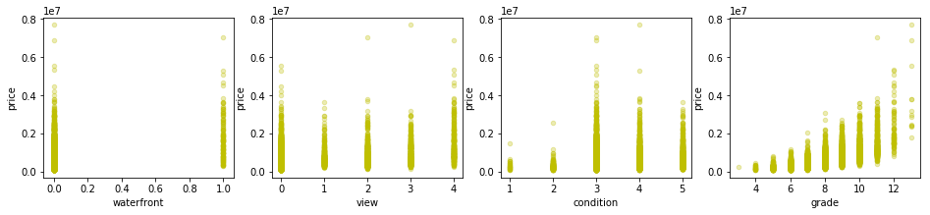
House price vs other Categorical Variables
Grade has a positive correlation with price.

Slide 13
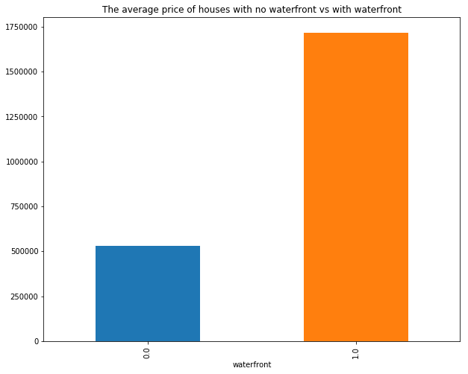
Waterfront

Slide 14
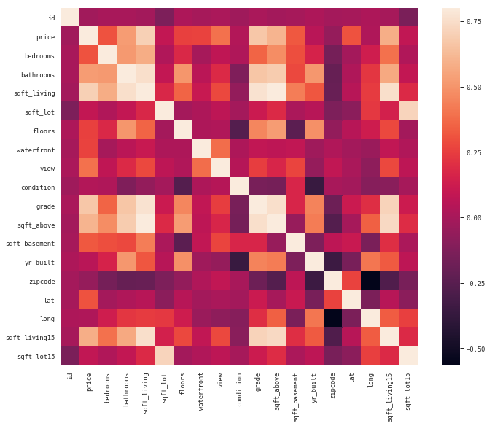
Correlation between variables
Variables that are highly correlated to price are:
sqft_living
sqft_above
grade
Independent variables which are highly correlated with each other:
sqft_living with sqft_living15, bathroom, grade, sqft_above
grade with bathroom, sqft_above, sqft_living15, sqft_living

Slide 15
Model Set up
Multiple Linear Regression on Price
Data Transformation:
Drop variables with high collinearity or poor quality (sqft_living15, sqft_lot15, yr_renovated)
Turn binary and ordinal variables into categorical values (bedrooms, bathrooms, waterfront, view, condition, grade, yr_built, zip code)
Log transformation and standardization on continuous variables
Package used for model: statsmodels, sklearn
Model selection method: Forward selection and Stepwise selection
Model validation: cross-validation
Notes:
Given an external estimator that assigns weights to features (e.g., the coefficients of a linear model), the goal of recursive feature elimination (RFE) is to select features by recursively considering smaller and smaller sets of features. First, the estimator is trained on the initial set of features and the importance of each feature is obtained either through a coef_ attribute or through a feature_importances_ attribute. Then, the least important features are pruned from current set of features. That procedure is recursively repeated on the pruned set until the desired number of features to select is eventually reached.

Slide 16
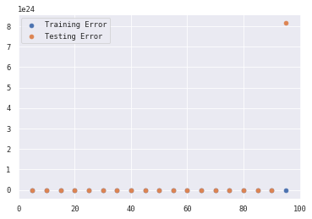
Model Result - 83 variables
Variables that significant impact to house price:
Footage of area above basement
Bathroom: 1.5-2, 2-2.5, 5-8
Bedroom: 1-2, 3-4, 4-5, 5-6
Grade: 6, 7, 8, 9, 10, 11, 12, 13
Zipcode: some of zipcodes
Year: 1925-1950, 1950-1975, 1975-1990, 1990-1995, 1995-2000
Model KPIs:
Adjusted R-sqaure: 0.839
P values: all p values is less than 0.05
Train MSE: 0.1615
Test MSE: 0.1607

Slide 17
Insights - grade
Grade begins to have significant impact on the house price till the level reaches 6 and the coefficient accelerates as the grade increases. It is important to pay attention to house grades when making investment decisions.

Slide 18
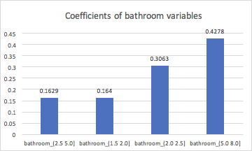
Insights - bathrooms
Number of bathrooms per bedroom has different impacts on house price in different bins. When it reaches 5-8 bathrooms per bedroom, the coefficient increased the most which may indicate a different kind of building.

Slide 19
Insights - zip code
Coefficients of zip code tell which area is more referable by the market. For long term investment, it is better to choose zip code with a positive coefficient.
Fastest growing areas
98039
98004
98112
98109
98119
Fastest declining areas
98022
98023
98001
98003
98092

